Slide 1
Lab 6 System Calls
CSC – 320 Operating System
Engr. Rahemeen Khan
Operating System

Slide 2
Review Linux System Architecture
Linux System Architecture is consists of following layers:
Hardware layer - Hardware consists of all peripheral devices (RAM/ HDD/ CPU etc.).
Kernel - Core component of Operating System, interacts directly with hardware, provides low level services to upper layer components.
Shell - a command process that allows you to control the computer via commands typed into a text interface.
Utilities - Utility programs giving user most of the functionalities of an operating systems
Daemons: These are background services (printing, sound, scheduling, etc) that either start up during boot, or after you log into the desktop.

Slide 3
What is system call?
In computing, a system call is the programmatic way in which a computer program requests a service from the kernel of the operating system it is executed on.
A system call is a way for programs to interact with the operating system.
System call provides the services of the operating system to the user programs via Application Program Interface(API).
It provides an interface between a process and operating system to allow user-level processes to request services of the operating system.
System calls are the only entry points into the kernel system.

Slide 4
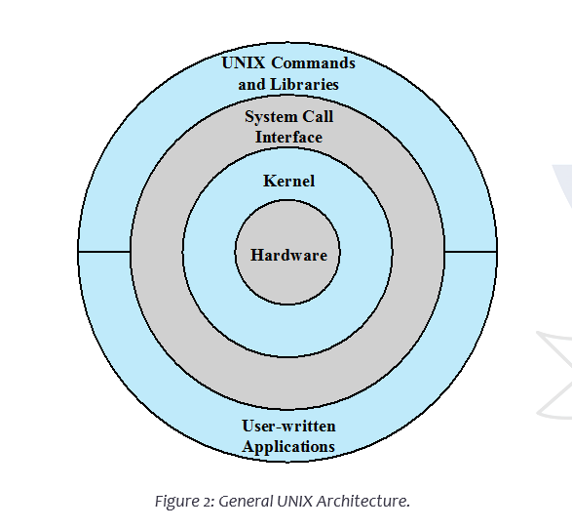

Slide 5
Services Provided by System Calls
Process creation and management
Main memory management
File Access, Directory and File system management
Device handling(I/O)
Networking, etc.

Slide 6
Types of system calls: There are several hundred system calls which can be roughly grouped into six categories
File system
Process
Scheduling
Interprocess communication
socket (networking)
Miscellaneous

Slide 7
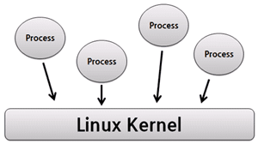
What is process?
Every running instance of a program is known as a process. The concept of processes is fundamental to the UNIX / Linux operating systems. A process has its own identity in form of a PID or a process ID.

Slide 8
System call for process:
Process Related
execve | Execute program.
exit | Terminate the calling process.
getpid | Get process identification.
setuid | Set user identity of the current process.
ptrace | Provide a means by which a parent process may observe and control the execution

Slide 9
Processes System Calls:
There are a lot many Linux system calls available inbuilt for the users.
A system call is as good as a function in C Programming Language.
It can be compared with ‘printf’ function in C.
The reason that it is often called system call rather than functions is that functions are limited to programming while system calls are specific for operating systems.

Slide 10
Fork System Call
In Linux, process is created by duplicating parent process. This is called forking. You invoke the fork system call with fork() function.
It is a system call that creates a new process under Linux operating system.
It takes no argument. The purpose of fork() is to create a new process which becomes the child process to the caller.
After the new child process is created, both processes will execute next instruction following the fork system call, therefore we have to distinguish the parent process from the child which can be done by evaluating the returned value of fork() function.
Returned Value from Fork
If the returned value is negative, it means that the child process creation was unsuccessful
If the returned value is zero, the child process is created with pid = 0
If the returned value is positive, the child process is created with the process with a process ID to the parent process (The returned process ID is of type pid_t defined in sys.type.h).

Slide 11
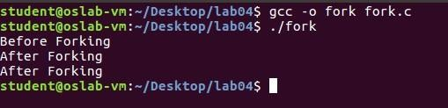
Example
Consider the following C language program:
#include<stdio.h>
#include <sys/types.h>
#include<unistd.h>
int main() {
printf(“before forking \n”);
fork();
printf(“after forking \n”);
return 0;
}

Slide 12
#include<stdio.h> #include <sys/types.h> #include<unistd.h> int i = 5; void parent_process(); void child_process(); int main() { pid_t pid; pid = fork(); if(pid == 0) { i += 10; child_process(); } else { parent_process(); } return 0; } void parent_process() { printf("I am a parent process and my value of 'i' is %d \n",i); } void child_process() { printf("I am a child process and my value of 'i' is %d \n",i); }

Slide 13
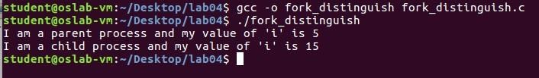

Slide 14

Processes System Calls:
What would happen if we had two calls to the fork( ) function, one below the other, in the same program?
The progression with each fork( ) that is added is 2 raised to the power of n, $2^{n}$, where n is the number of calls to fork( ). The program below will create four processes.

Slide 15
#include<stdio.h> #include <sys/types.h> #include<unistd.h> int main () { fork(); fork(); printf("hello world \n”); return 0; }

Slide 16
System Call to Get Process IDs
There are two system calls (functions) which can get the Process ID one is to get the process ID of the current process and another one to get the ID of its parent process. These are:
‘getpid()’ returns the PID of current process
‘getppid()’ returns the PID of parent’s process
Example
Consider the following example that prints PID, if a child then it prints its parent’s PID and if it’s a parent then it prints its own PID.

Slide 17
#include<stdio.h> #include <sys/types.h> #include<unistd.h> int main() { pid_t pid; pid = fork(); if(pid == 0) { printf("I am child and my parent is %d and my own PID is %d\n", getppid(), getpid()); } else if(pid > 0) { printf("I am a Parent and my pid is %d\n", getpid()); } return 0; }

Slide 18

In the above example, after the fork, if the process is a child it prints its own PID along with its parent PID else if it is a parent then it prints its own PID and exits.

Slide 19
Function Arguments in C Language
If a function is to use arguments, it must declare variables that accept the values of the arguments.
These variables are called the formal parameters of the function.
Formal parameters behave like other local variables inside the function and are created upon entry into the function and destroyed upon exit.
While calling a function, there are two ways in which arguments can be passed to a function:
Call by value
Call by reference

Slide 20
Calling by Value:
This method copies the actual value of an argument into the formal parameter of the function. In this case, changes made to the parameter inside the function have no effect on the argument.
By default, C programming uses call by value to pass arguments. In general, it means the code within a function cannot alter the arguments used to call the function.
Consider the function swap() definition on next slide.

Slide 21
#include<stdio.h> #include<unistd.h> void swap(int a, int b); int main() { int c=100,d=200; printf("Before swap, value of a : %d\n",c); printf("Before swap, value of b : %d\n",d); swap(c,d); printf("after swap, value of a : %d\n",c); printf("after swap, value of b : %d\n",d); return 0; } void swap(int a, int b) { int temp; temp=a; a=b; b=temp; }

Slide 22
TASKS
Task 1: Write what you have learned in few lines on each of the three programs that were using the fork() system call.
Task 2: Write a C program that uses fork() system call to print a single line eight times without using for loop and repeated printf command.
Task 3: Code the C program given below and explain what it does along with providing a snapshot of the output. Investigate and write about the usage of execlp() system call.

Slide 23
#include<stdio.h> #include<string.h> #include<sys/types.h> #include<unistd.h> #include<stdlib.h> int main() { int pid; pid = fork(); if (pid < 0) { fprintf(stderr, "Fork failed!\n"); exit(-1); } else if (pid == 0) { printf("I am the child, return from fork=%d\n", pid); execlp("/bin/ls", "ls", NULL); } else { printf("I am the parent, return from fork, child pid=%d\n", pid); } }

Slide 24
Task 4: Write a program to declare a counter variable initialized by zero. After fork() system call two processes will run in parallel both incrementing their own version of counter and print numbers 1 -5 . After printing numbers child process will sleep for three second, then print process id of its grandparent and terminates by invoking a gedit editor. Meanwhile, its parent waits for its termination.

Slide 25
ThankYou

